Slide 1
Home Assignment 3
#Q1. Write a python program to concatenate only the last three charachters of both strings and print the output.
string_1 = "London"
string_1 = "Tokyo"
#expectedoutput: donkyo
string_1 = "London"
string_2 = "Tokyo"
string_3 = string_1[-3:] + string_2[-3:]
print(string_3)
#Q2. Write a python program to create a list with values apple,mango,banana,
blueberry,orange and then print only the first two values from the following List
fruits = ["apple","mango","banana","blueberry","orange"]
print(fruits[:2])
#Q3. Write a python program to remove the value "apple" and insert value
"pineapple" at the same index in the above list. Print the list once modified
fruits.remove("apple")
fruits.insert(0,"pineapple")
print(fruits)

Slide 2

Set, Dictionary, Membership
A mother identifies her twin off-springs uniquely; not-so-naïve?
Ashish Pimple
Prathmesh Palande
Pratik Loya
TOC EUS Automation
May 14, 2019

Slide 3
Section 1
Set, Dictionary, Membership

Slide 4

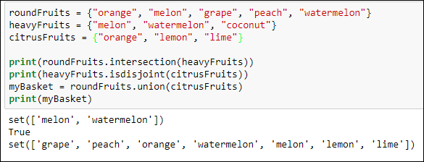
Sets
Set – unordered collection of items with no duplicate elements
Sample Methods:
add
remove
copy
clear
difference
difference_update
pop
update
discard
intersection
intersection_update
isdisjoint
issubset
issuperset
symmetric_difference
symmetric_difference_update
union
Create set:

Slide 5
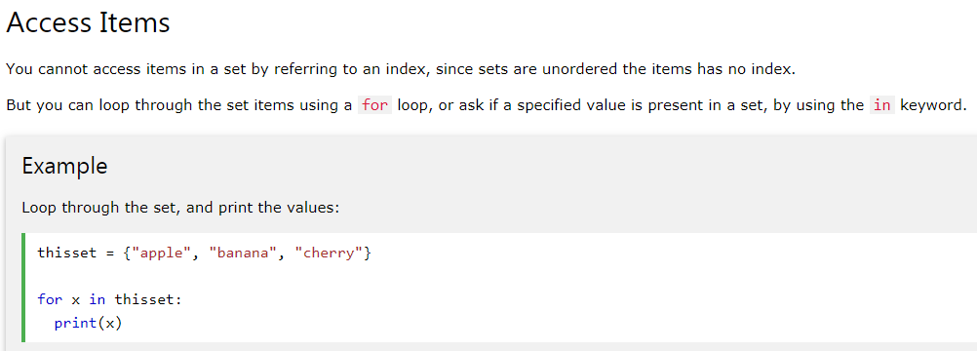
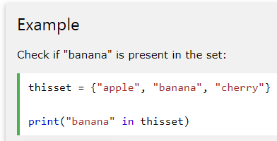
Sets

Slide 6
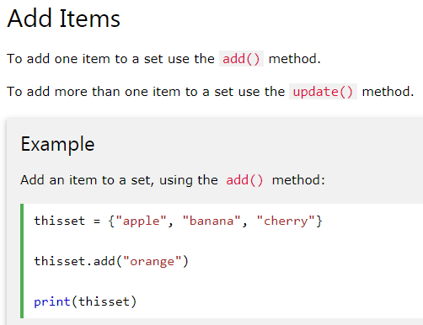
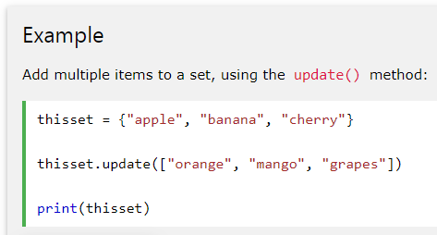
Sets

Slide 7
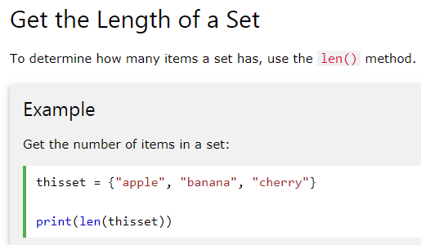
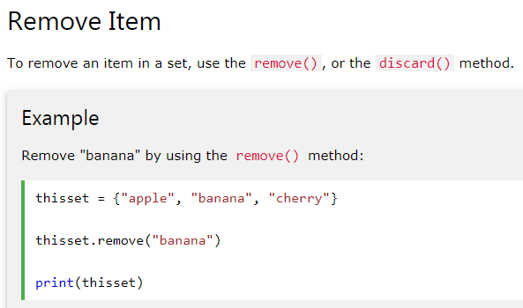
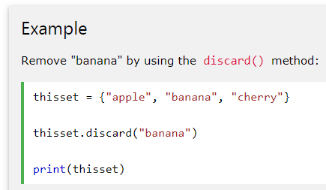

Sets

Slide 8
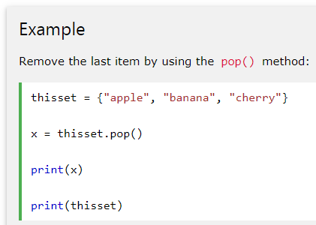
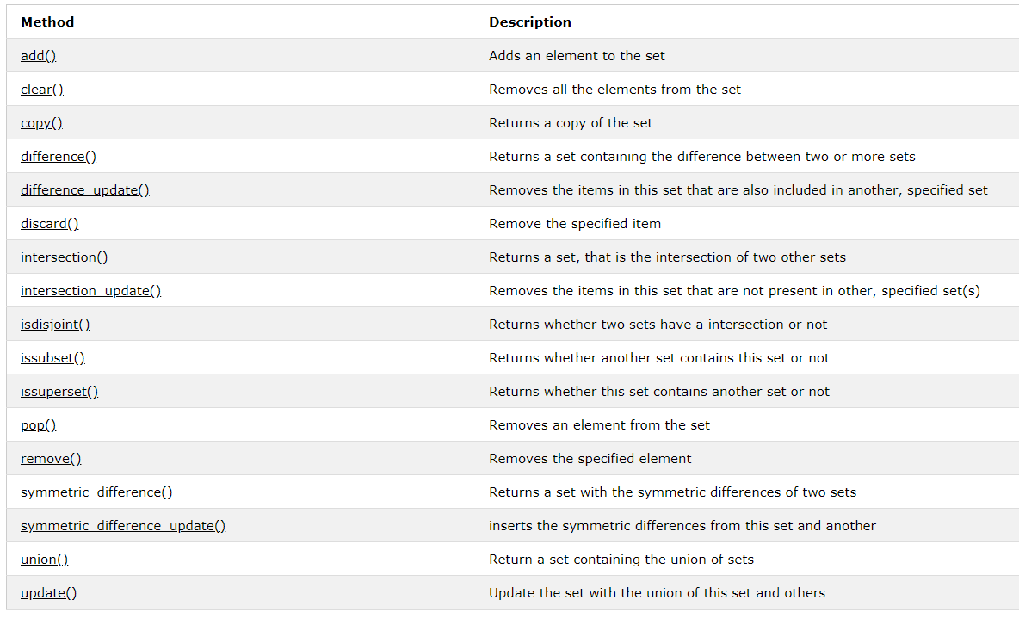
Sets
All the methods for Sets

Slide 9
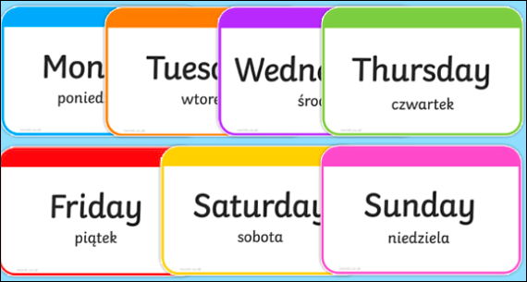



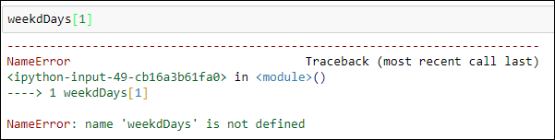
Dictionaries
- Dictionary – unordered and mutable collection of items
Create dictionary:
Accessing Items
The wrong way

Slide 10

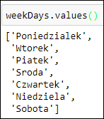
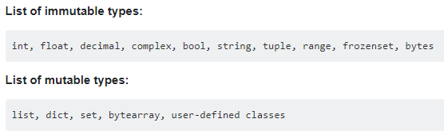
Dictionaries, in-a-nut-shell
Creating a new dictionary
newDict = {key : value}
Keys and values
Any hashable type can be used as a dictionary key
Immutable: Hashable
Mutable: Not Hashable

Slide 11
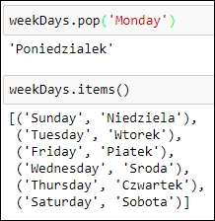
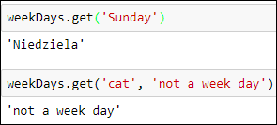
Playing around with Dictionaries
Methods:
keys
values
items
get
copy
fromkeys
popitem
setdefault
pop
Update
clear

Slide 12
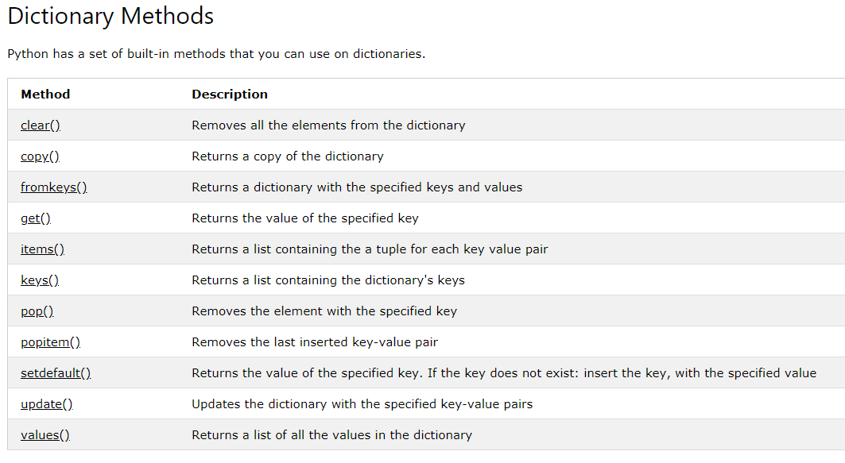
Methods for Dictionaries

